Slide 1

Project Review 4
Course Code 24DEA3101
Faculty : Dr. N. Shirisha
Associate Professor
Real-Time Banking Transaction Analytics & Anomaly Monitoring Platform
FDE TEAM 21
B Raghu Nandan 2420030058
C Pravin Sai 2420030777
J Hemanth 2420039805

Slide 2
ABSTRACT
BankFlow Analytics is an end-to-end data engineering project that captures and processes synthetic banking transaction data in real time. The system uses a Python-based generator to create realistic transaction events, Apache Kafka to stream them reliably, and PySpark Structured Streaming to validate, deduplicate, and enrich each transaction with rolling-window features. A rule-based, fully explainable anomaly detection engine scores every transaction using weighted signals such as unusually high amounts, transaction bursts, repeated failures, location jumps, new devices, and unusual hours, and any record that fails schema or business validation is automatically routed to a separate quarantine layer instead of breaking the pipeline. Valid, enriched records are written to Bronze and Silver Delta Lake tables and are subsequently loaded into a SQLite-based Gold layer organised as a star schema with dimension, fact, and KPI tables. The complete ingestion-to-warehouse pipeline was containerised using Docker and executed end-to-end with a live Kafka broker and a live Spark Structured Streaming job, and the resulting Gold warehouse was verified and queried directly using SQL. This project demonstrates a working, reproducible real-time analytics pipeline and lays the foundation for future orchestration and dashboarding layers.

Slide 3
INTRODUCTION
Digital banking platforms continuously generate transaction data through activities such as transfers, UPI payments, card payments, ATM withdrawals, deposits, and bill payments. Understanding this data as it arrives, rather than after the fact, is important for spotting unusual account behaviour early and for keeping downstream reporting fresh. This project, BankFlow Analytics, builds a real-time pipeline that generates synthetic transaction events, streams them through Apache Kafka, and processes them with PySpark Structured Streaming. Every transaction is validated against a canonical schema, cleaned, deduplicated, and scored for anomalies using transparent, rule-based logic rather than a black-box model, so that every flag comes with a plain-language reason. Valid data flows into a Bronze and Silver Delta Lake, and is further summarised into a Gold-layer star schema in SQLite for analytical querying. The goal of this review is to demonstrate that this pipeline runs correctly end-to-end, from data generation through to a queryable warehouse, using real Kafka and Spark infrastructure rather than a simulated stand-in.

Slide 4
LITERATURE SURVEY
Several recent works have explored real-time transaction monitoring and fraud or anomaly detection. Work on near real-time anomaly detection using a Lambda Architecture highlights that maintaining separate batch, speed, and serving layers increases operational complexity, and suggests a simpler, unified layered approach such as the Medallion architecture used in BankFlow Analytics. Other studies on real-time fraud detection using machine learning discuss modelling approaches but do not integrate a complete pipeline covering ingestion, validation, storage, and reporting. Work focused on real-time financial data processing with Apache Spark and Kafka concentrates mainly on stream-processing performance and gives limited attention to handling invalid or malformed records, motivating BankFlow's dedicated Quarantine layer. Alternative implementations built on Kafka Streams with Spring Boot, or on managed commercial streaming platforms, demonstrate real-time fraud detection but rely on frameworks outside the open-source Kafka-Spark ecosystem used here. Broader surveys of streaming and time-series anomaly detection, along with scalable frameworks such as SCARFF for credit-card fraud detection with Spark, confirm that streaming anomaly detection is an active research area, but existing academic implementations rarely combine real-time ingestion, explainable rule-based anomaly scoring, a dedicated invalid-record quarantine layer, and a queryable analytical warehouse in a single, reproducible, open-source pipeline. BankFlow Analytics addresses this gap by integrating these components into one containerised, end-to-end system.

Slide 5
METHODOLOGY
Data Generation — Python (with Faker) generates synthetic banking transactions across seven transaction types, six channels, and four statuses, with configurable injection of five anomaly patterns.
Data Ingestion — Transactions are published to Apache Kafka topics using a producer with retries and acknowledgement guarantees, running on a broker deployed in KRaft mode via Docker.
Stream Processing — PySpark Structured Streaming reads continuously from Kafka, applies a watermark, deduplicates records, and validates each transaction against a canonical schema.
Validation & Quarantine — Records failing required-field, amount, timestamp, type, or status checks are enriched with a failure reason and routed to a Quarantine Delta table; valid records proceed to Bronze/Silver.
Anomaly Scoring — Silver-layer records are enriched with rolling-window features and scored using a deterministic, weighted rule engine, producing an explainable score, band, and reason string.
Gold Layer & Querying — Silver data is loaded into a SQLite star schema (dimensions, fact table, KPI tables), which is queried directly with SQL to validate quality and extract insights.

Slide 6
IMPLEMENTATION
Data Generation Module — Python + Faker-based generator producing schema-compliant and deliberately malformed records; validated with 11 unit tests covering account generation, schema conformance, and all five anomaly patterns.
Streaming & Ingestion Module — Kafka topic management and producer implemented with kafka-python-ng; topics created idempotently; broker run in Docker (KRaft mode, single broker).
Processing Module — PySpark Structured Streaming job performing schema validation, watermark-based deduplication, rolling-window aggregation, and anomaly scoring.
Storage Module — Delta Lake tables for Bronze (raw valid transactions), Silver (cleaned, scored transactions), and Quarantine (invalid records with failure reasons), backed by checkpointed streaming writes.
Gold Layer Module — SQLAlchemy-based loaders populate a SQLite star schema (dimensions, fact_transactions, KPI tables), with dedicated data-quality validation queries.
Containerisation & Testing — A custom Docker runtime image bundles PySpark, Delta Lake, and Kafka client libraries; 17 automated unit and integration tests were written and executed against the pipeline.

Slide 7
COMPARISON AND DISCUSSION
Aspect | Base Paper
Architecture | Lambda Architecture with separate batch, speed, and serving layers
Ingestion | General streaming ingestion layer; implementation details not specified
Processing | Batch and speed layers processed independently, then merged in a serving layer
Anomaly Detection | Near real-time detection performed at the speed layer
Storage | Separate batch-layer and serving-layer stores, adding operational complexity
Invalid Data Handling | Not explicitly addressed in the architecture
Reproducibility | Requires maintaining three distinct layers / pipelines

Slide 8
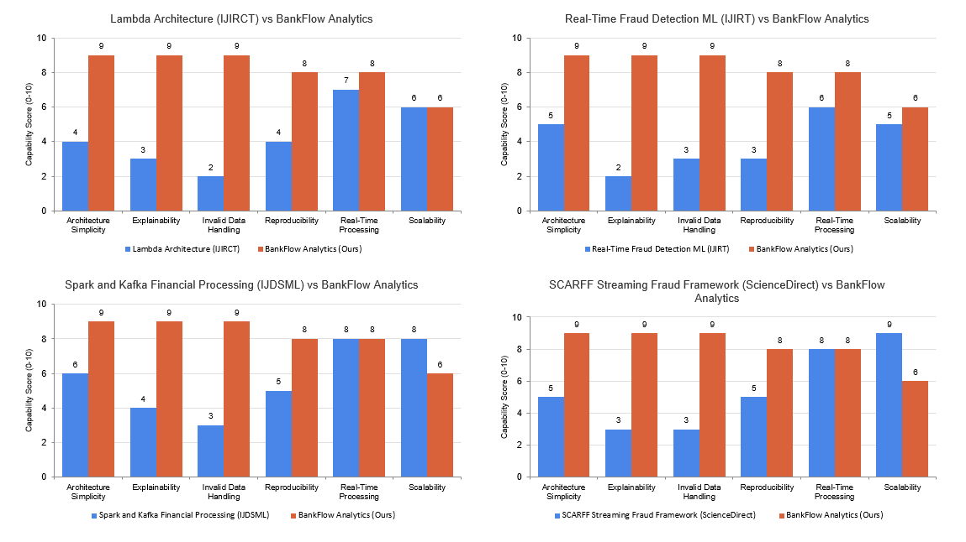
COMPARISON AND DISCUSSION

Slide 9
DISCUSSION (CONTINUED):
Bankflow Analytics Replaces The Three-layer Lambda Design With A Single, Unified Medallion Architecture (Bronze → Silver → Gold), Reducin Operational Complexity, As The Base Paper Itself Recommends Exploring.
Ingestion Is Made Explicit And Reproducible Using Apache Kafka Running In Docker With Retry-based, Acknowledgement-driven Delivery.
A Dedicated Quarantine Layer, Absent In The Base Paper's Design, Isolates Malformed Or Invalid Transactions Without Interrupting The Main Stream.
Anomaly Detection Is Fully Rule-based And Explainable (Weighted Scoring With Plain-language Reasons), Rather Than An Opaque Detection Stage.
The Entire Pipeline — Ingestion, Processing, Storage, And Warehouse Loading — Is Reproducible With Docker, And Was Executed And Verified End-to-end As Part Of This Review.
Current Limitation: Anomaly Thresholds Are Manually Configured Rather Than Learned From Real Transaction Distributions, And The Deployment Is Single-broker / Single-node.

Slide 10
RESULTS
Kafka broker deployed successfully in KRaft mode via Docker; all three topics created idempotently (`bank_transactions`, bank_transactions_quarantine, `bank_transactions_anomaly`).
PySpark Structured Streaming job started successfully and simultaneously opened three Delta Lake sinks (Bronze, Silver, Quarantine), confirmed via live application logs.
The synthetic generator produced live transaction traffic that was consumed by the streaming job in real time through Kafka.
In an end-to-end pipeline run, 1,514 raw events were generated: 1,482 passed validation and 32 were correctly quarantined for schema/data violations.
The rule-based anomaly engine flagged 467 of 1,482 valid transactions (~31.5%) as ANOMALY-band, each carrying explainable reasons such as HIGH_AMOUNT, TRANSACTION_BURST, or REPEATED_FAILURES.
The Gold-layer SQLite warehouse was populated with a full star schema; direct SQL browsing confirmed 2,100 rows across 10 tables, including fact_transactions and account_risk_summary.
Data-quality validation queries confirmed zero orphaned foreign keys, zero inconsistent anomaly flags, and zero invalid transaction amounts in the Gold layer.
All 17 automated unit and integration tests passed, covering generation, validation, anomaly detection, transformations, and the Silver-to-Gold pipeline.

Slide 11
CONCLUSION
A working, end-to-end real-time transaction pipeline was implemented and executed: Python generator → Apache Kafka → PySpark Structured Streaming → Delta Lake (Bronze/Silver/Quarantine) → SQLite Gold star schema.
The anomaly detection engine is fully explainable, giving every flagged transaction a human-readable reason rather than an opaque score.
The Quarantine layer ensures malformed data cannot break downstream processing, directly addressing a gap identified in the literature survey.
The pipeline is reproducible: it was containerised with Docker and executed with real Kafka and Spark infrastructure, not a simulated substitute.
Automated testing (17 passing unit/integration tests) and dedicated data-quality validation queries confirm the correctness of the Gold-layer warehouse.
Current scope is a single-broker, single-node deployment with manually configured anomaly thresholds; workflow orchestration and dashboarding are planned next steps rather than completed components.

Slide 12
FUTURE DIRECTION
Integrate Apache Airflow to automate and schedule the Silver-to-Gold batch load, replacing the current manual execution.
Connect a business intelligence tool (e.g., Power BI) to the Gold-layer SQLite warehouse for interactive dashboards covering transaction volume, value, and anomaly trends.
Tune anomaly-scoring thresholds using statistical baselines derived from real or larger synthetic transaction volumes rather than fixed manual values.
Extend the anomaly engine with additional signals (e.g., merchant-category risk, velocity-based rules) and evaluate precision/recall once labelled data is available.
Scale the deployment to a multi-broker Kafka cluster and a multi-node Spark deployment for higher throughput.
Add CI-based automated test execution to run the existing test suite on every change.

Slide 13
REFERENCES
"Near Real-Time Anomaly Detection in Customer Transactions Using Lambda Architecture," IJIRCT.
"Real Time Fraud Detection Using Machine Learning," IJIRT.
"Real-Time Financial Data Processing Using Apache Spark and Kafka," IJDSML.
"Real-Time Fraud Detection with Kafka Streams and Spring Boot," Medium.
"Real-Time Data Streaming to Detect Financial Fraud Using Condense," Zeliot.
"Real-Time Fraud Detection Using Kafka and Machine Learning," DEV Community.
"Anomaly Detection: A Survey," ACM Computing Surveys.
"SCARFF: A Scalable Framework for Streaming Credit Card Fraud Detection with Spark," ScienceDirect.
"Credit Card Fraud Detection: A Realistic Modeling and a Novel Learning Strategy," IEEE.
"Sequence Classification for Credit-Card Fraud Detection," ScienceDirect.
Apache Software Foundation, "Apache Kafka Documentation," kafka.apache.org.
Apache Spark Project, "Structured Streaming Programming Guide," spark.apache.org.
Delta Lake Project, "Delta Lake Documentation," delta.io.

Slide 14
THANK YOU

